Slide 1



Presented by Upputholla Sreenu
E-COMMERCE SALES
15-AD-HOD
INISGHTS

Slide 2
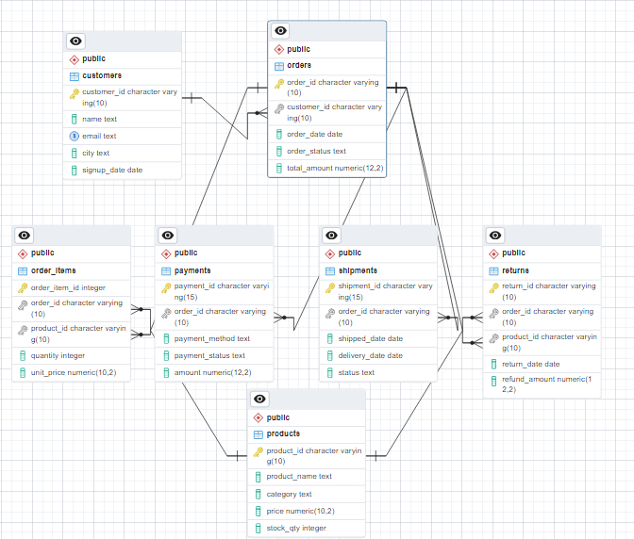

Input Data
tools Used

Slide 3

15-Business Requires
1. Monthly revenue trend → How much sales per month (last 12-24 months).
2. Top 10 best-selling products by revenue and units.
3. Category performance - Which category contributes the most revenue?
4. Top 10 customers by lifetime purchase value.
5. Customer retention % of repeat customers vs one-time buyers.
6. City-wise sales - Which cities generate maximum revenue?
7. Average order value (AOV) per month and per customer.
8. Order status distribution - Delivered vs Cancelled vs Returned.
9. Payment success rate Which method (UPI, Credit Card, etc.) is most reliable?
10. Shipment efficiency - Avg. delivery time by city/product category.
11. Return/refund analysis Which products/categories have the highest return rate?
12. Customer churn analysis - Customers active last year but inactive this year.
13. Top product per category - Highest selling item in each category.
14. Revenue share of top 20% customers (Pareto 80-20 rule).
15. Fraud detection → Orders marked Delivered but with Failed payment.
tools Used

Slide 4
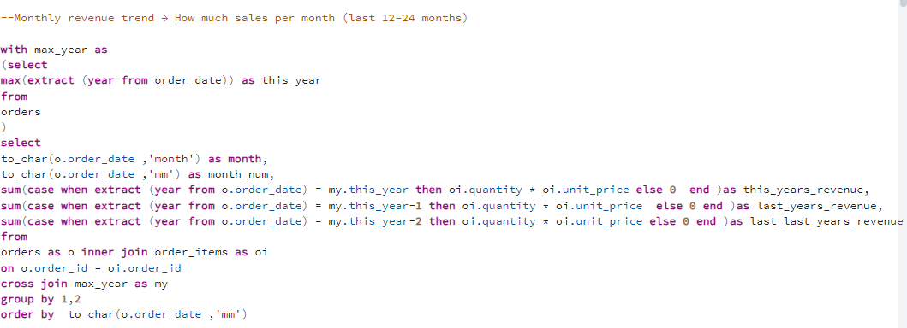
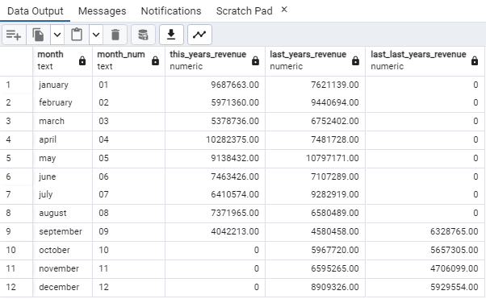
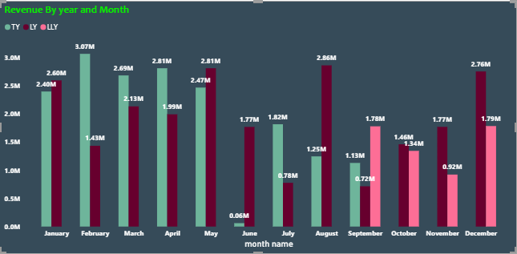
1. Monthly revenue trend → How much sales per month (last 12-24 months).
Output

Slide 5
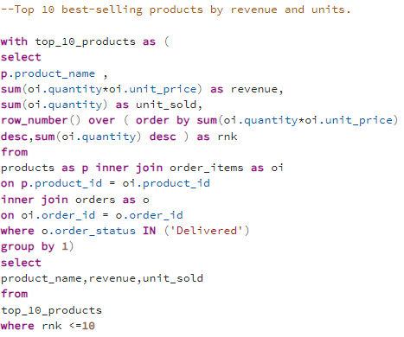
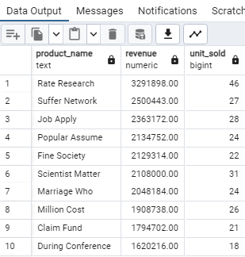
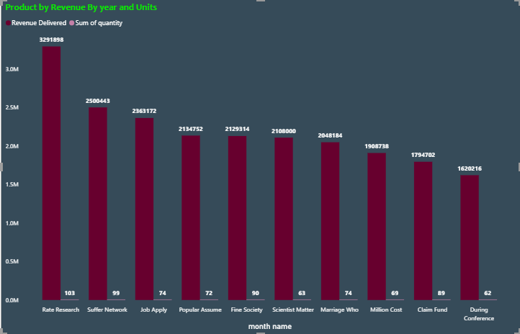
2. Top 10 best-selling products by revenue and units.
Output

Slide 6
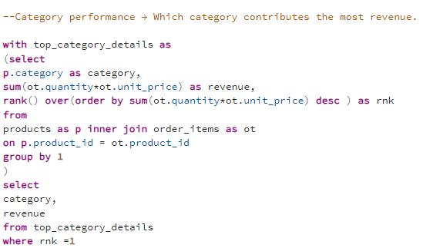
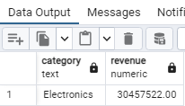
3. Category performance - Which category contributes the most revenue?
Output

Slide 7
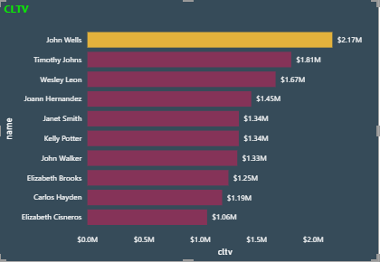
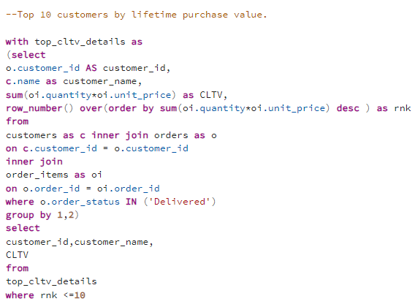
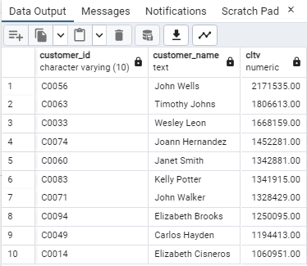
4. Top 10 customers by lifetime purchase value.
Output

Slide 8
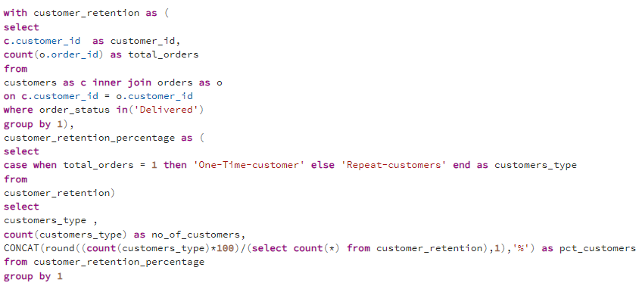
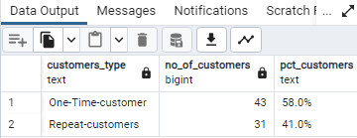
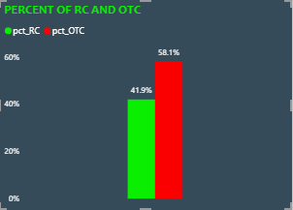
5. Customer retention % of repeat customers vs one-time buyers.
Output

Slide 9
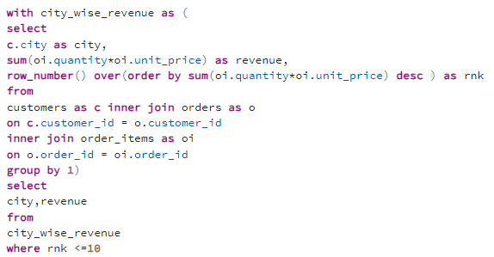
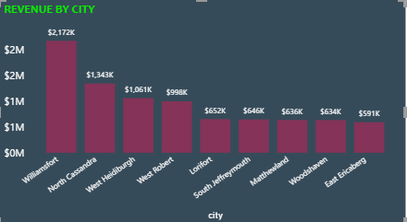
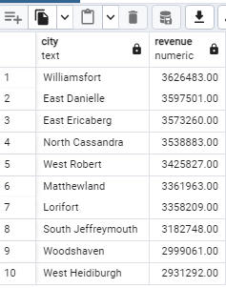
6. City-wise sales - Which cities generate maximum revenue?
Output

Slide 10
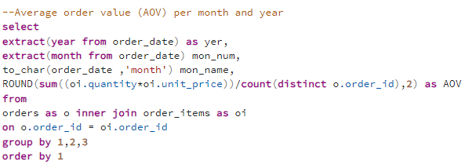
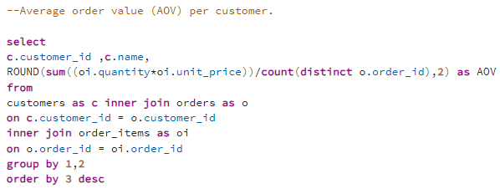
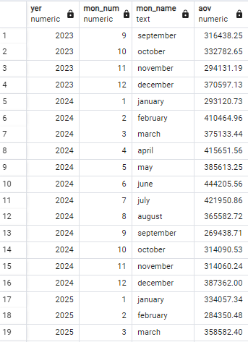
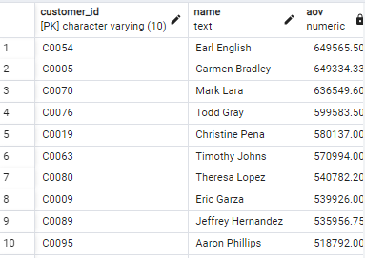
7. Average order value (AOV) per month and per customer.
Output
Output

Slide 11
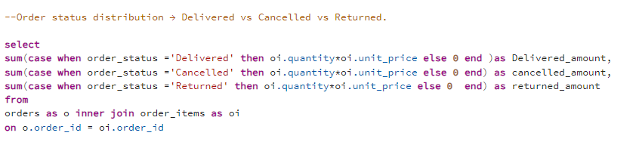
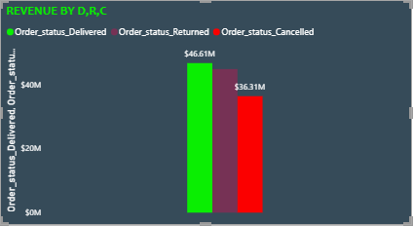
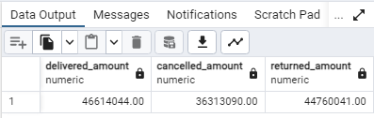
8. Order status distribution - Delivered vs Cancelled vs Returned.
Output

Slide 12
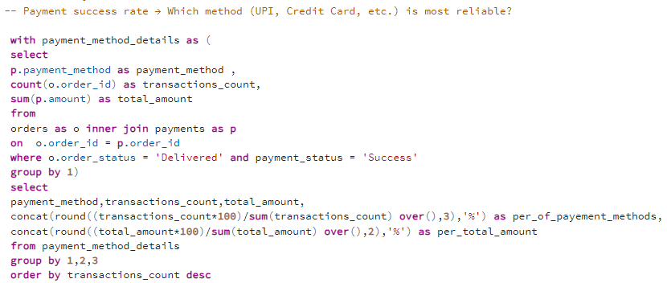
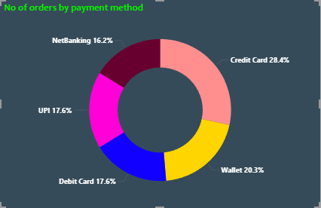
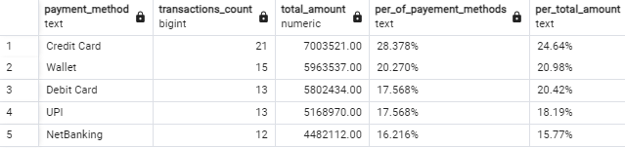
9. Payment success rate Which method (UPI, Credit Card, etc.) is most reliable?
Output

Slide 13
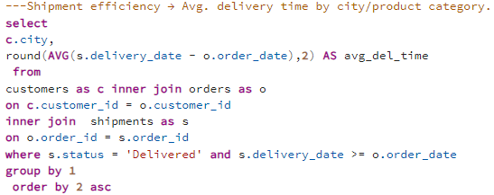
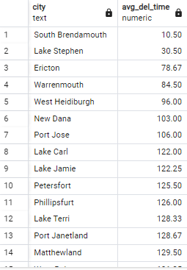
10. Shipment efficiency - Avg. delivery time by city/product category.
Output

Slide 14
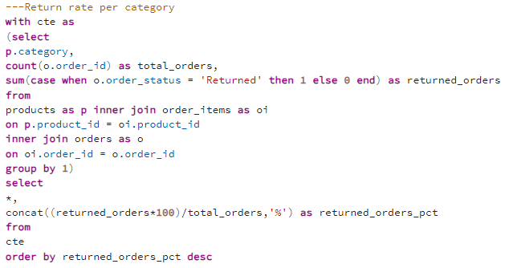
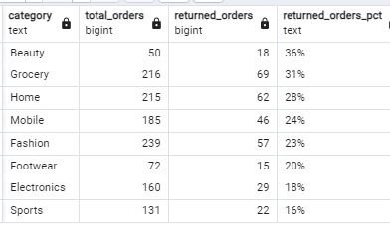
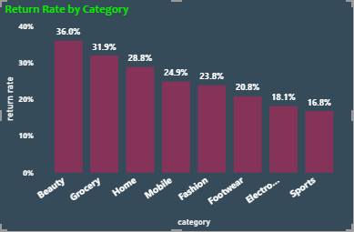
11. Return/refund analysis Which products/categories have the highest return rate?
output

Slide 15
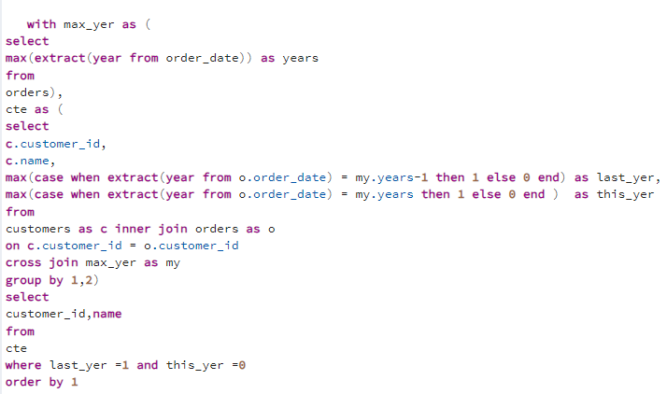
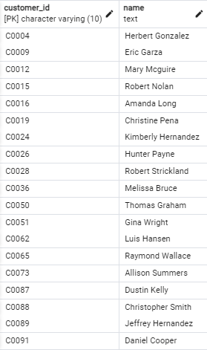
12. Customer churn analysis - Customers active last year but inactive this year.
Output

Slide 16
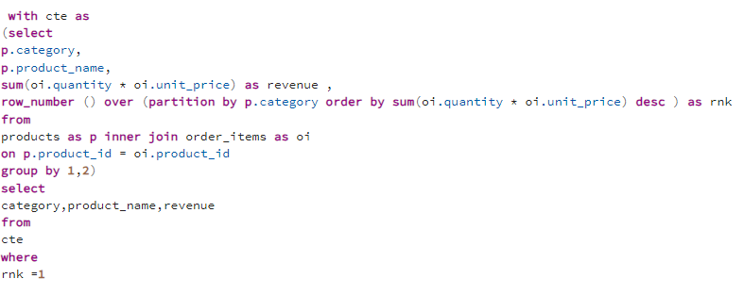
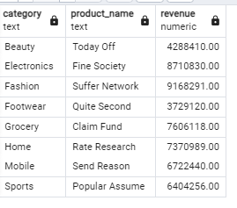
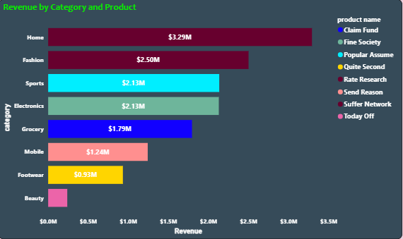
13. Top product per category - Highest selling item in each category.
Output

Slide 17
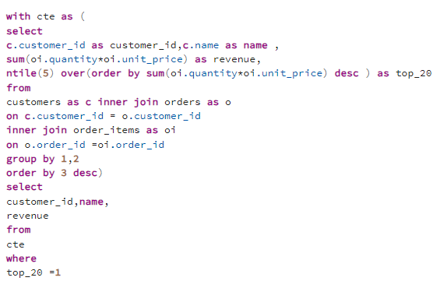
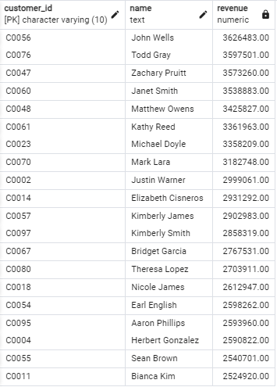
14. Revenue share of top 20% customers (Pareto 80-20 rule).
Output

Slide 18
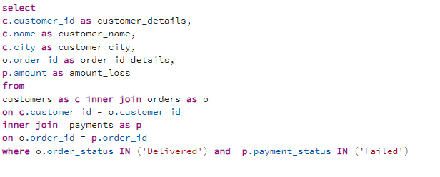
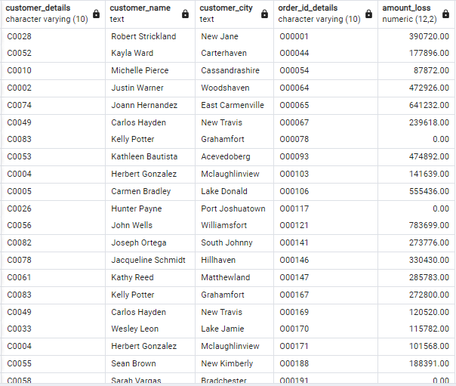
15. Fraud detection → Orders marked Delivered but with Failed payment.
Output

Slide 19
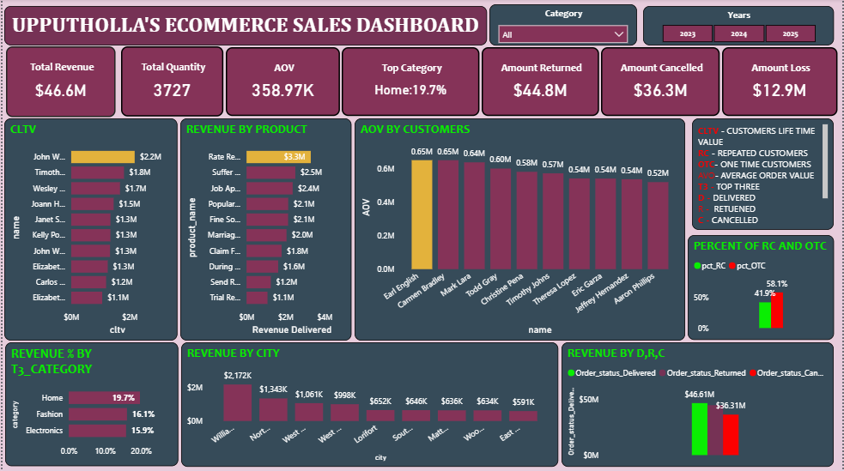
Dashboard

Slide 20
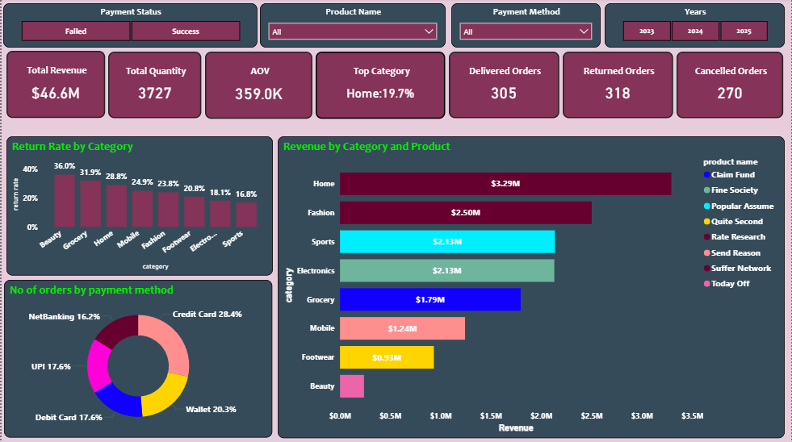

Slide 21
